Slide 1


CI Models, Challenges, Best Practices Frank Würthwein OSG Executive Director Professor of Physics UCSD/SDSC

Slide 2
Size Matters
Expensive Instruments with long run times warrant large CI investments.
A Billion $$ international project that runs for 50 years will need to exert different levels of control over its CI destiny than a 10 Million one that runs for 5 years.
With wealth comes responsibility!
larger (better funded) projects ought to provide some CI value to the common good.
There must be cross facility CI projects that the large facilities can collaborate with, contribute to, and benefit from.
The NSF ought to encourage rather than prevent such contributions to the common good.
Mission focused thinking can be detrimental !

Slide 3
Science is a Team Sport
Xenon1T
VERITAS
SPT3G

Slide 4
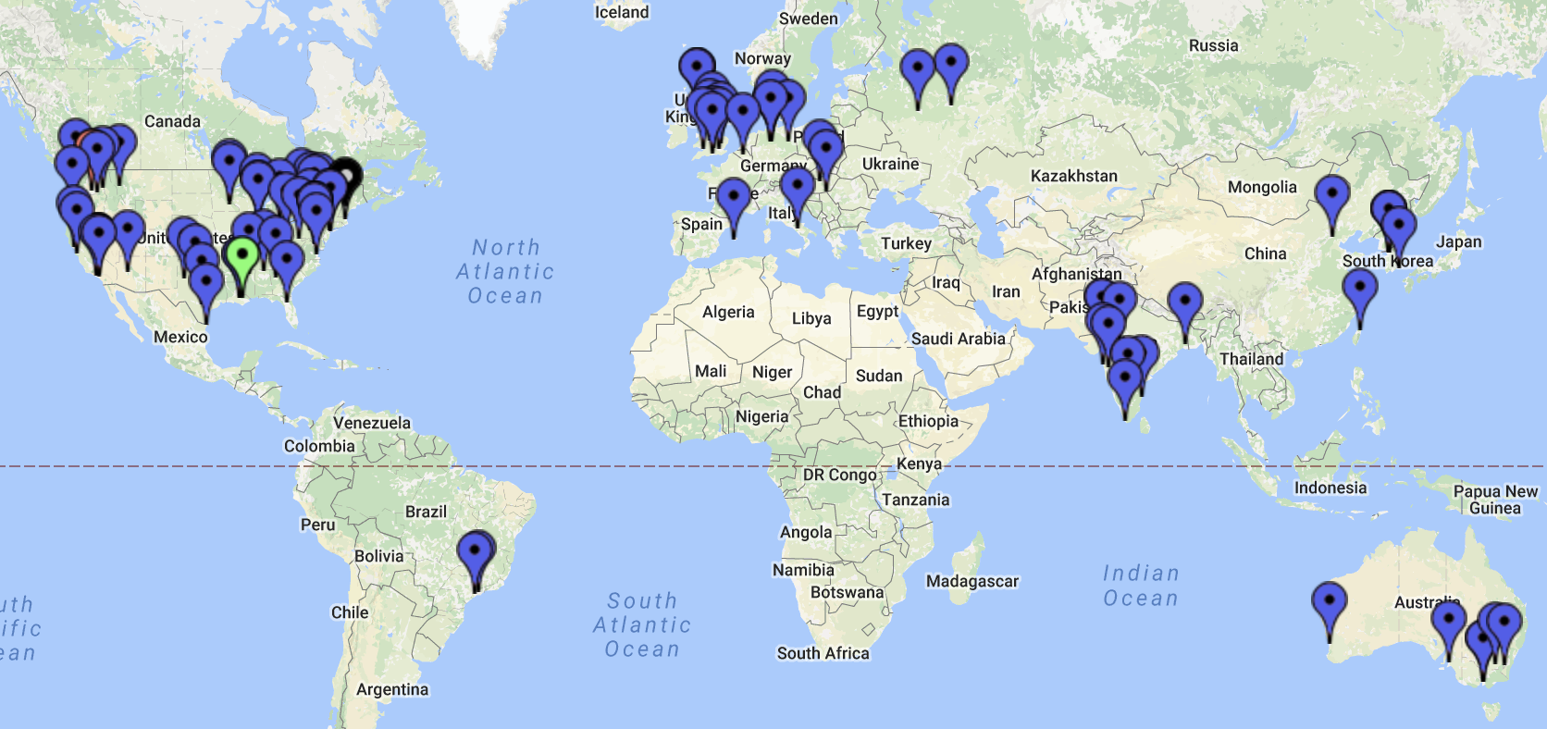
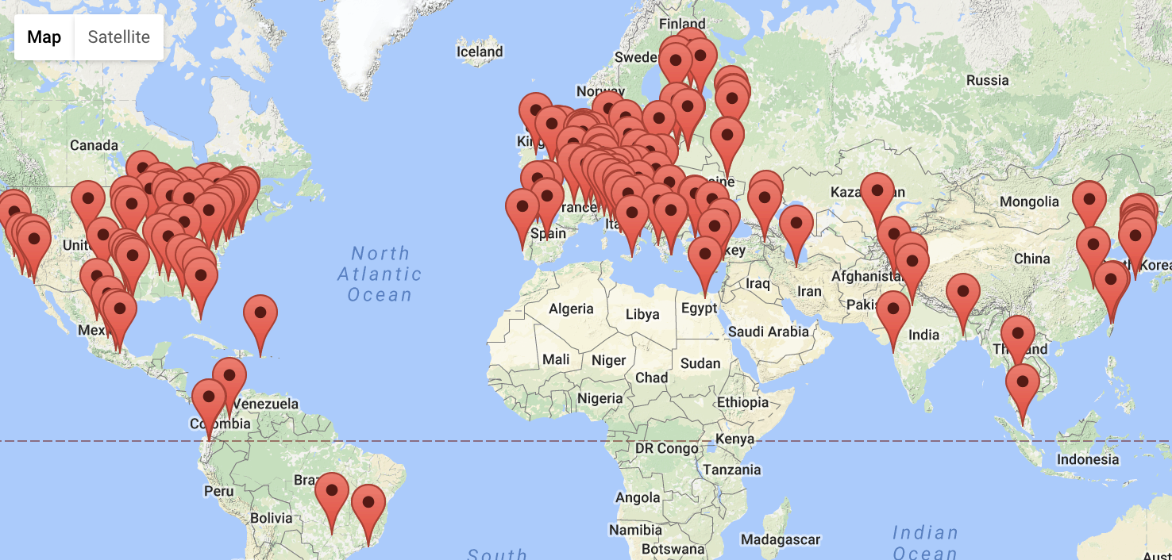
An international Team Sport
LIGO and Virgo Scientific Collaboration
CMS Collaboration
Many of the LIGO/Virgo
institutional members are also
institutional members of
ATLAS or CMS or IceCube or ...
Universities can play a special role in CI because
they occupy the overlap in the science venn diagram.

Slide 5
Typical University Investments
US Universities commonly operate:
compute clusters from 10k to 40k cores
storage infrastructures from 1-10 Petabytes
campus networks that connect labs at 10Gbps with 100Gbps WAN connectivity.
multi-million $$ annual budgets for research computing groups.
Research benefits from integrating
these investments across institutions.
Researchers benefit from collaborating with their institutional CI.

Slide 6
Research IT Business Model at Universities
Colocation facilities provide free space, power, cooling, networking to PIs at the University.
PIs across all domains buy compute and storage hardware.
Poor kids benefit from Rich kids via sharing of spare capacity.
Institutional funds add entry-level support to provide migration path for poor kids to become rich kids.
Research facilitation accelerates this migration.
Local resources fully integrated into national & commercial resources.
Elastic scale out to shrink time to solution.
Sharing resources of collaborators across institutional boundaries to shrink time to solution and/or share data.
Hybrid CI is cheaper than any monolith !!!

Slide 7
The OSG Vision in a nutshell
Across the nation, institutions invest into research computing to remain competitive
Science is a team sport, and institutions with an island mentality will underperform.
Integration is key to success
OSG provides services
to advance this vision

Slide 8
Transparent Computing across different resource types
National Supercomputer
Allocation
Collaborator’s Cluster
OSG
Metascheduling
Service
Access Point
sharing
Nationally Shared Clusters
purchasing
Commercial Cloud
Local Cluster
OSG integrates computing across different resource types and business models.

Slide 9
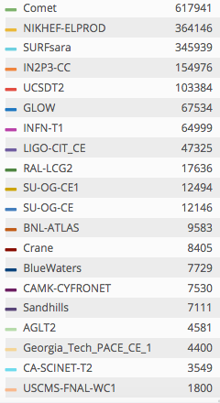
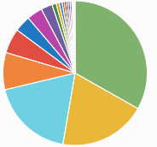
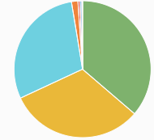
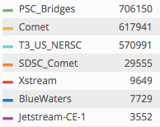
Recent Examples of computing across resource types (Compute hours)
last 30 days global use
by LIGO/Virgo via OSG
includes:
XSEDE allocation ,
Collaborating institutions
in US & EU & Canada ,
and opportunistic sharing.
CMS during Supercomputing 2016
last 30 days national HPC use via OSG

Slide 10
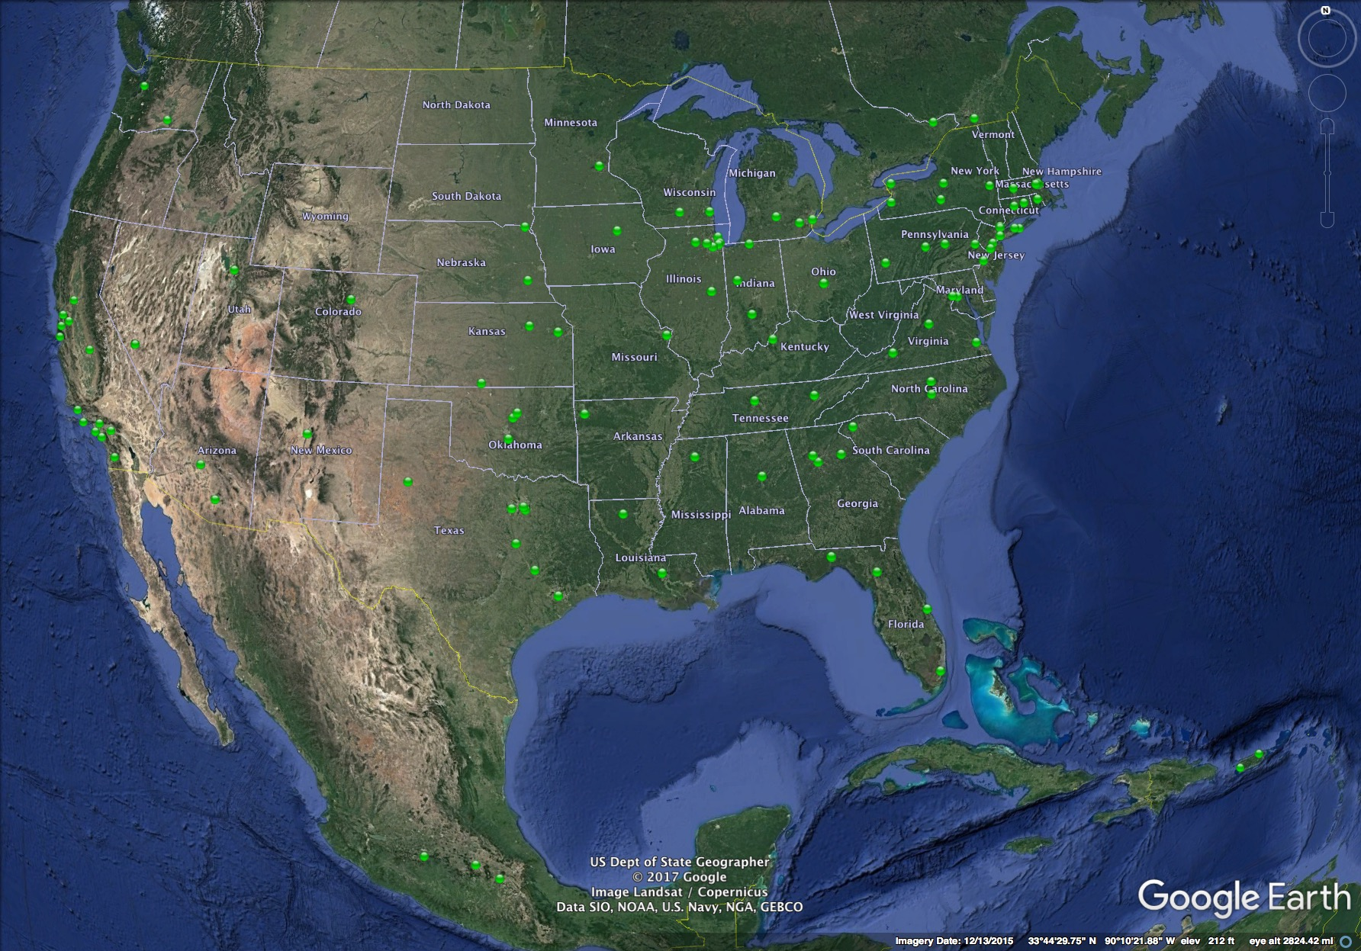
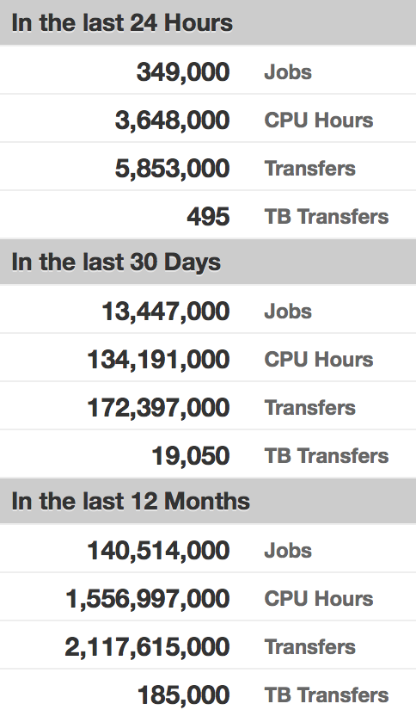
Integrating Compute & Storage Clusters
Each green dot represents a
cluster registered in OSG

Slide 11
OSG Data Federation
Applications connect to regional cache transparently.
Regional cache asks redirector for location of file.
Redirector redirects to relevant origin.
File gets cached in regional cache.
Xrootd OSG
Redirector
Xrootd Origin
A
…
Xrootd Origin
B
Xrootd regional
cache
…
Xrootd regional
cache
XRootd
XRootd
XRootd
XRootd
XRootd
XRootd
XRootd
XRootd
Data Server
XRootd
Data Server
XRootd
Data Server
XRootd
Data Server
XRootd
Data Server
Data Server
Data Server
Data Server
Data Server
Data Server
Data Server
Data Server
One Data Origin per Community
Multiple caches across US
LHC experiments operate Data Federation across ~150PB disk worldwide

Slide 12
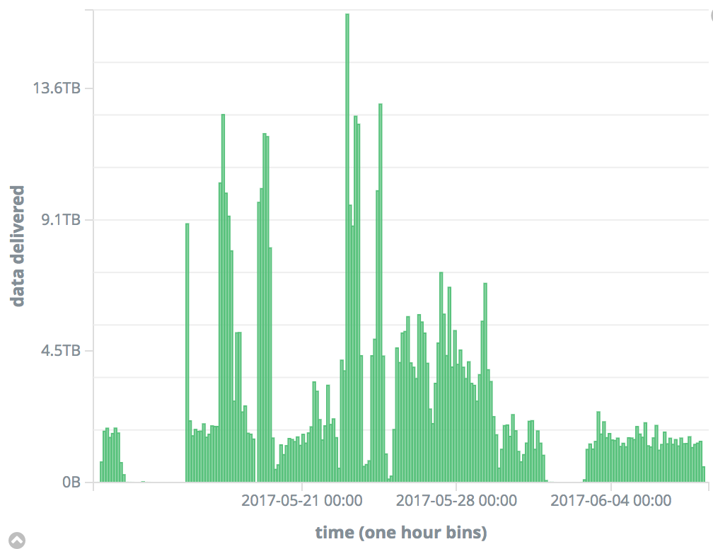
Big Data beyond Big Science
OSG caching infrastructure used at up
to ~10TB/hour for meta- or exo-genetics

Slide 13
OSG Business Model
OSG’s business model is to empower Scientists and their home institutions to work together for long term sustainability.
OSG provides knowledge & software infrastructure.
OSG can offer storage and service hosting to jump start projects, but prefers to enable institutions for growth and sustainability.
OSG provides global integration across commercial and academic computing.
OSG respects local ownership and control.

Slide 14
CI Software Reuse Examples
HTCondor for overlay batch system
overlay can be specific to science collaboration
glideinWMS for resource provisioning
provisioning can be specific to science collaboration to achieve special privileges at collaborating institutions, use allocations, and include commercial cloud.
Pegasus for workflows
CVMFS
establish uniform execution environment on all resources either via distributed module environment or singularity containers
secure namespace for data federation
XROOTD for data federation and data caches.
each community can have its own data origin and share or own caches at compute clusters.
Rucio for data transfer management
gridftp, the open source version for disk to disk transfers
Technology reuse across science communities.

